Slide 1
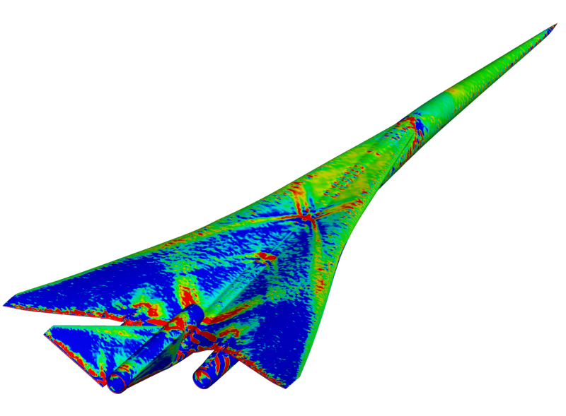
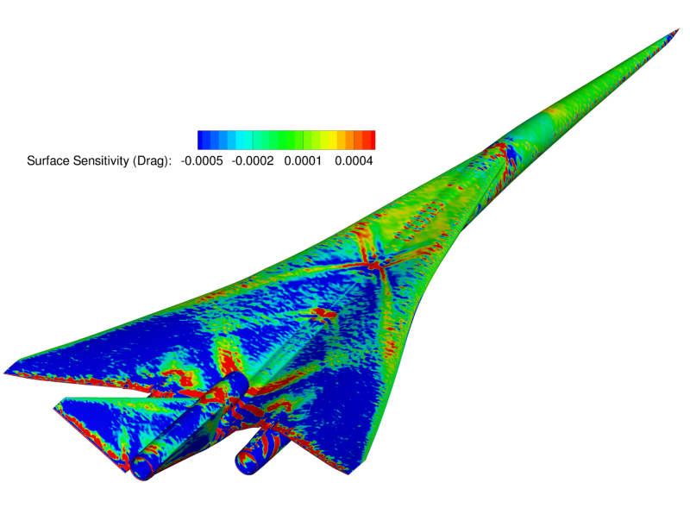
Supersonic Aircraft Shape Design Powered by SU² and Pointwise

Slide 2
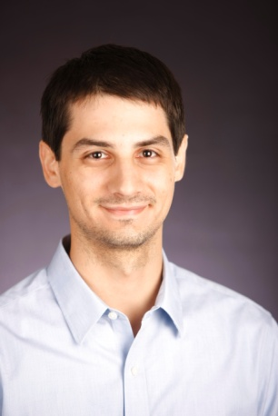

Presenters
Travis Carrigan
Travis Carrigan joined Pointwise as a senior engineer after completing his M.S. in aerospace engineering at The University of Texas at Arlington in May 2011 where his graduate research involved aerodynamic design optimization. He interned at Pointwise beginning May 2008, producing demonstration and application videos and working in technical support, doing grid projects and quality assurance testing. During a prior internship at Vought Aircraft Industries, Mr. Carrigan worked as a quality engineer on the Boeing 787 Dreamliner Program. As a senior engineer at Pointwise, Mr. Carrigan works with clients to strengthen their CFD processes by developing interactive and automated meshing solutions.
Thomas Economon
Thomas D. Economon is currently a PhD candidate in the Aerospace Design Laboratory (ADL) within the Department of Aeronautics & Astronautics at Stanford University. His research focuses on the development of new design methodologies for aerospace systems, including high-fidelity, adjoint-based techniques for optimal shape design, as well as tools for design at the conceptual level. He has extensive experience with high performance computing and the development of CFD platforms, most notably as a member of the core development team for the open-source SU^2 software suite. He holds a BS in Aerospace Engineering from the University of Notre Dame (2008) and an MS in Aeronautics & Astronautics from Stanford University (2010).

Slide 3


Presenters
Francisco Palacios
Dr. Palacios is an Engineering Research Associate at the Department of Aeronautics and Astronautics at Stanford University. His main areas of expertise include optimal aerodynamic shape design, large-scale multi-physics CFD simulations, and numerical analysis. Prior to his arrival at Stanford University in 2011, Dr. Palacios was research lead for technological innovation at the Madrid Institute for Advanced Studies and coordinator of the Airbus program “Future Simulation Concepts”. From 2011 to 2013, Dr. Palacios was responsible for the development of the main RANS solver for the Stanford PSAAP center, and for the research in adjoint-based methodologies to manage the uncertainties that are present in hypersonic combustion environments. Currently, Dr. Palacios research is focused on supersonic aircraft design and the development of novel shape design techniques applied to multi-physics problems.
Trent Lukaczyk
Trent Lukaczyk is a Ph.D. candidate in the Aerospace Design Lab at Stanford University. His core research interests are in aircraft design and optimization methods, and he is currently contributing to the design of NASA's next-generation Supersonic Passenger Jet. This work depends on experience of various disciplines that he gained from several internships and during his undergraduate education at Cornell University: developing meshing tools, simulating the aerodynamics of both aircraft and automobiles, testing those designs in the wind tunnel, and even designing combustion engines.

Slide 4
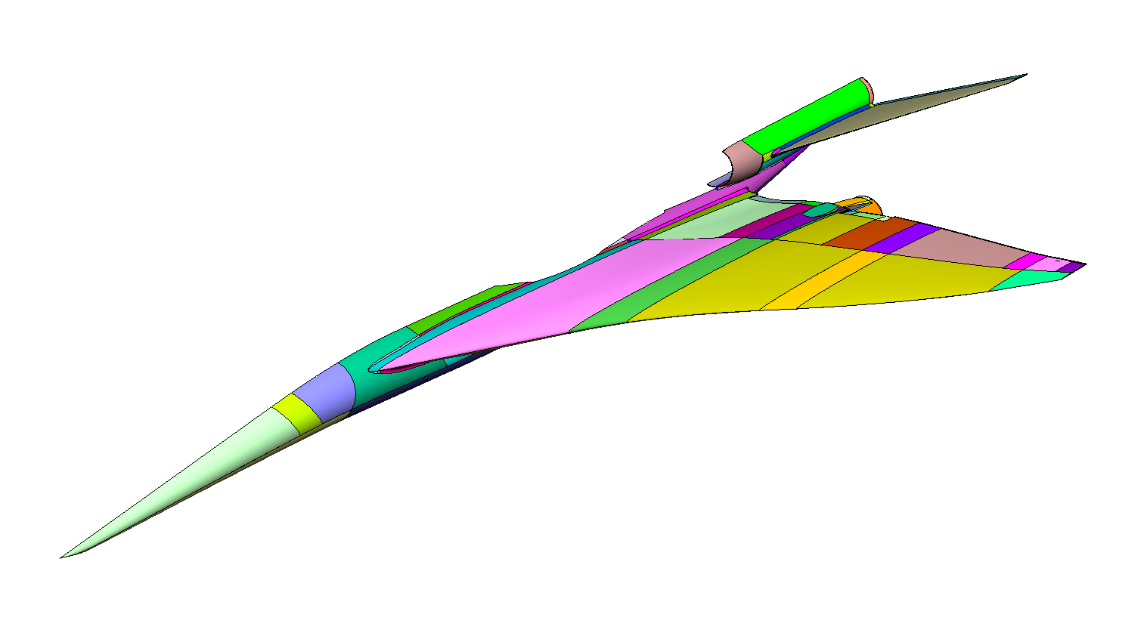
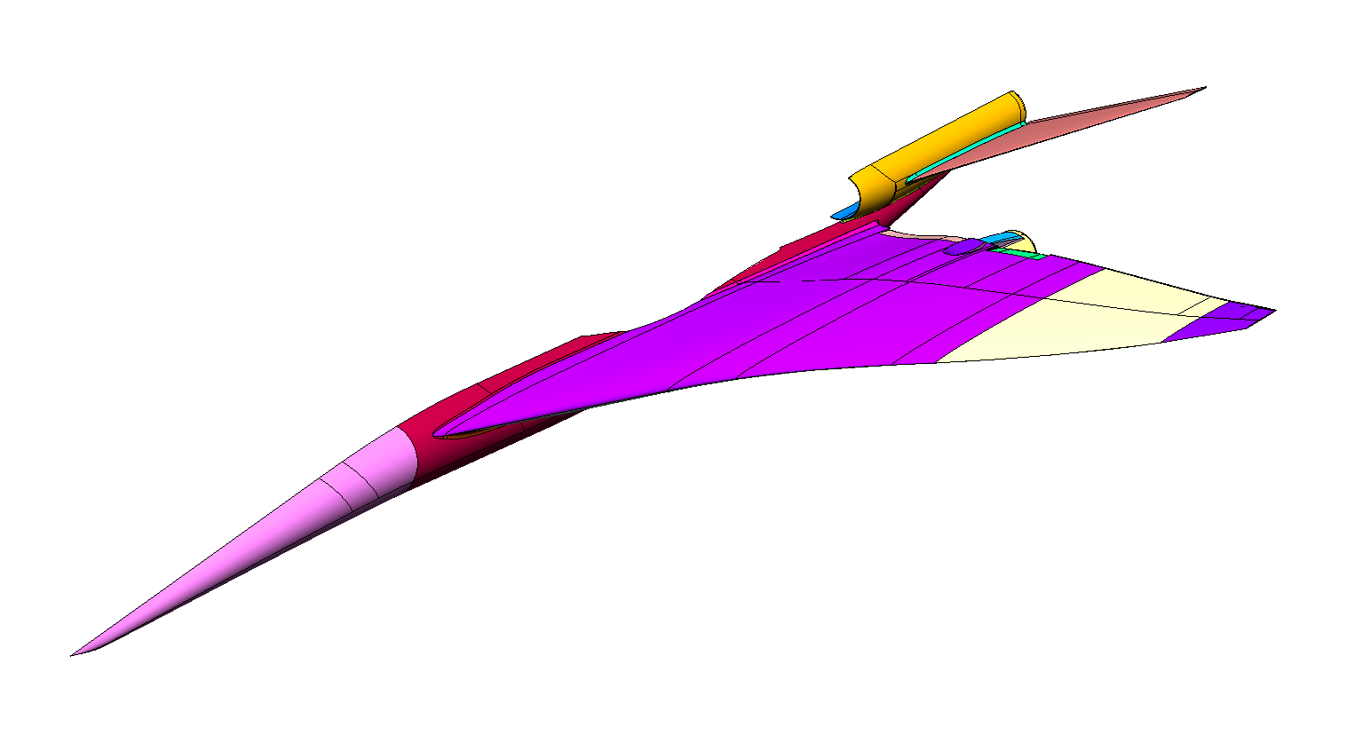
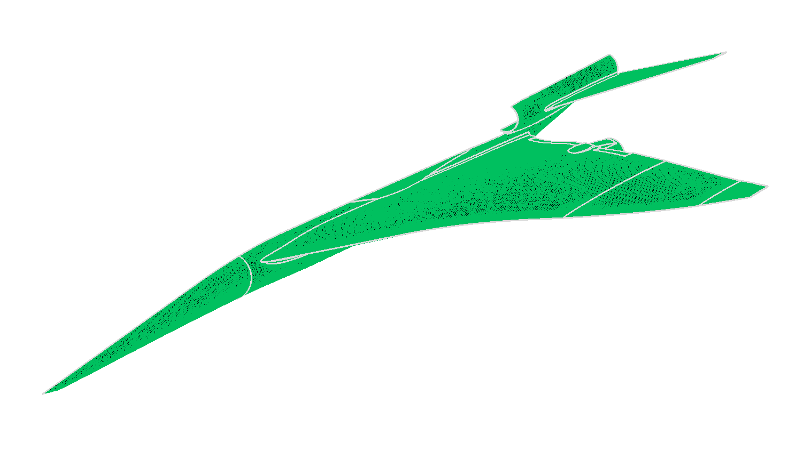
Solid Meshing

Slide 5

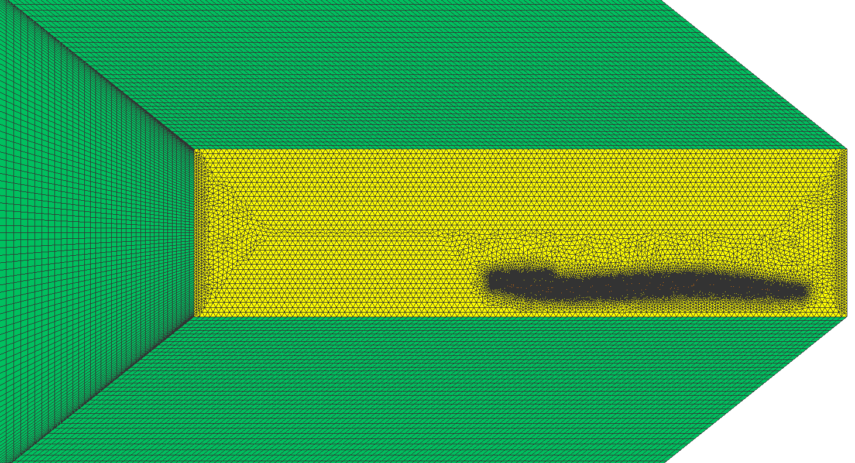
Volume Meshing

Slide 6
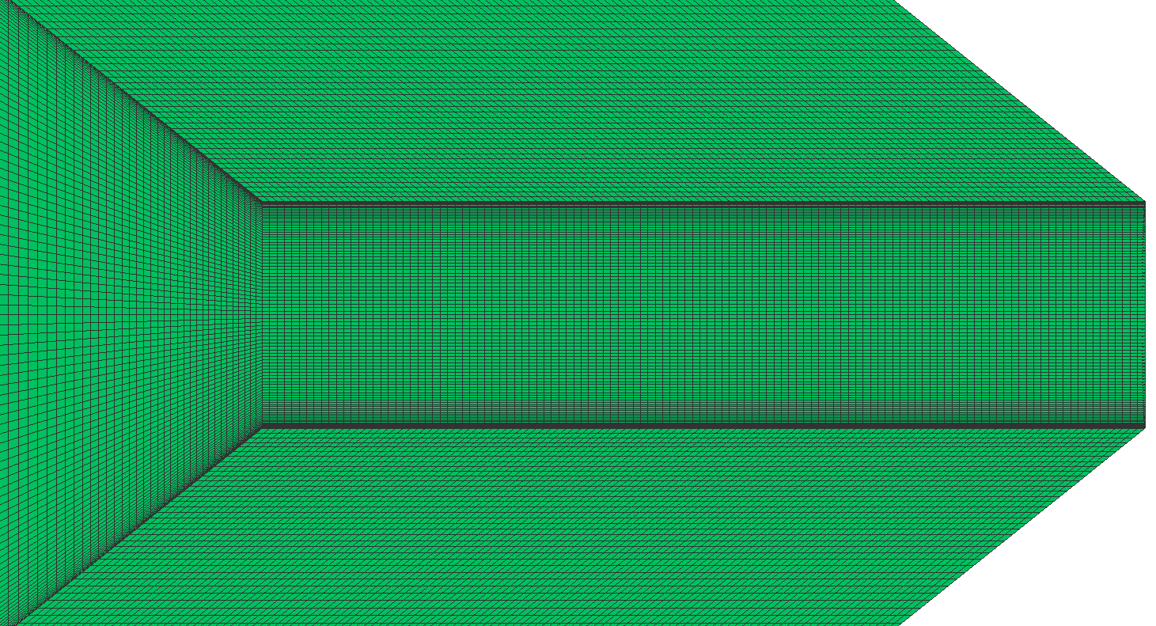
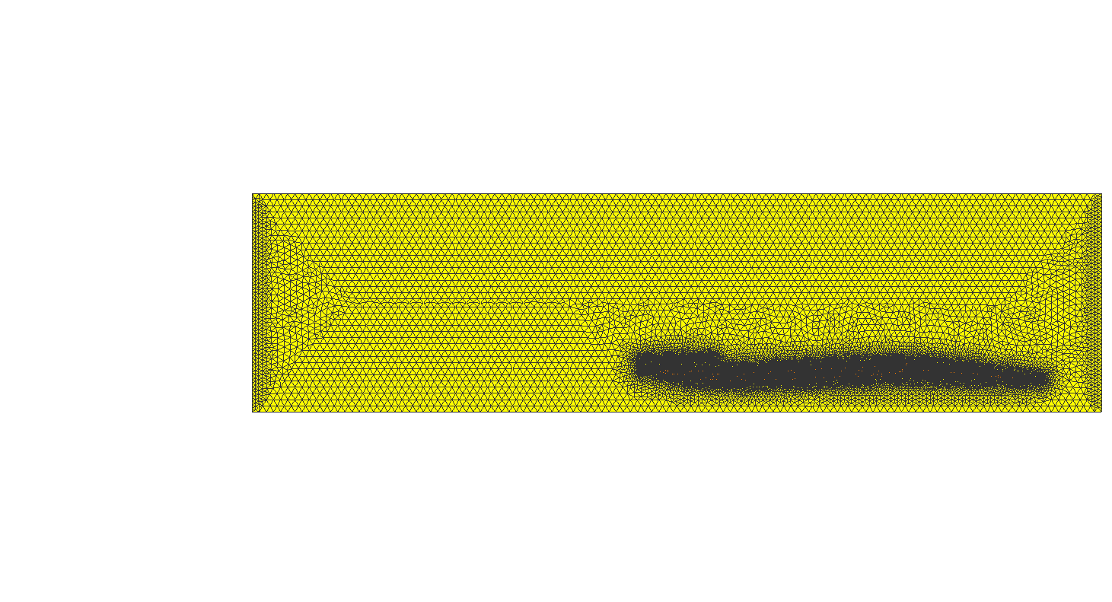
Volume Meshing
Mach-aligned hex elements
Tet core block

Slide 7
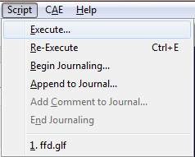
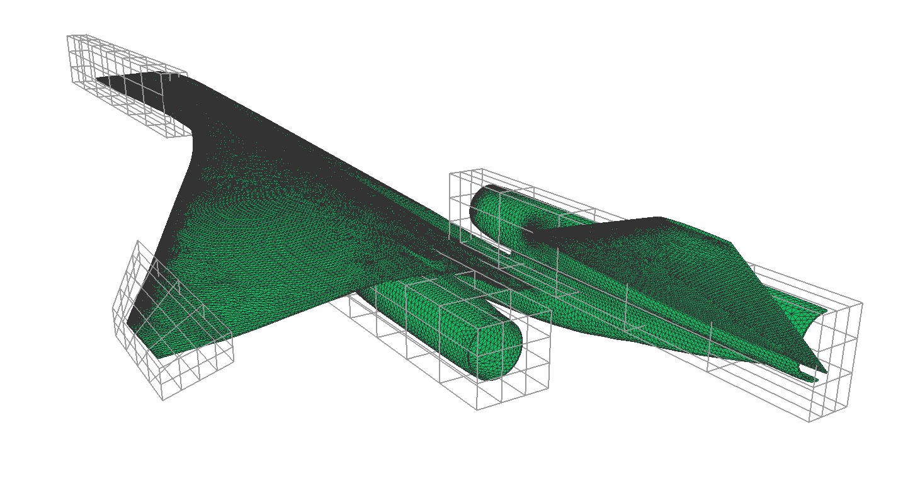
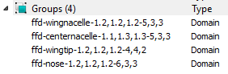
FFD Boxes

Slide 8
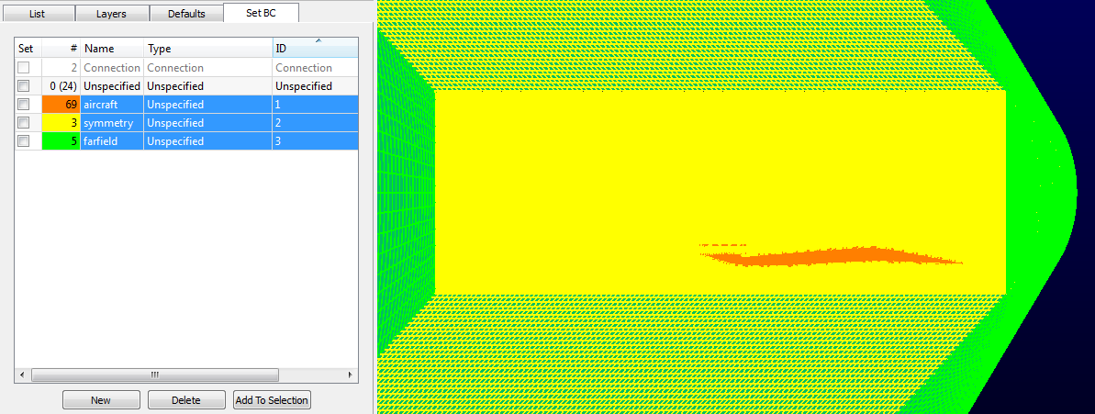
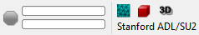
Native SU² Support

Slide 9
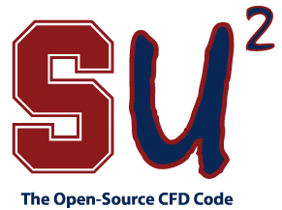
Shape Design in SU²
Today’s webinar is based on SU² V3.1. See
http://su2.stanford.edu for much more information!
Open-source suite for CFD, shape design, + much more
SU² is also capable of multi-physics calculations
Industry-standard numerical methods on unstructured grids
Object-oriented C++ modules and Python scripts
Once a baseline geometry/mesh is available, SU² can be used for analyzing performance, evaluating sensitivities, and automatic shape design

Slide 10
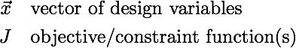
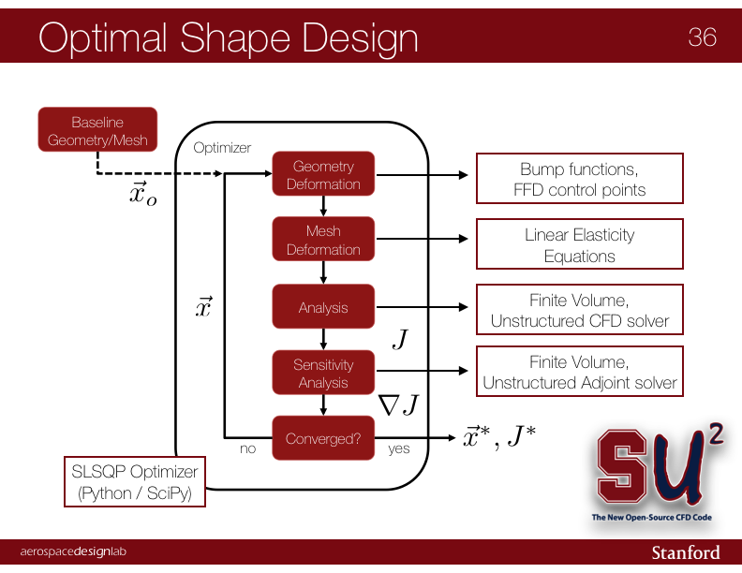
Optimal Shape Design Loop

Slide 11
Shape Design in SU²
There are a lot of moving parts in the design loop…
However, SU² provides everything you need for design
Configure each module within a single config file (.cfg)
With everything in place, call shape_optimization.py
Python automates the shape design loop for you
$ shape_optimization.py –f LM-1021.cfg –p 96
‘-f’ specifies config filename
‘-p’ specifies number of procs for parallel jobs

Slide 12
Shape Design in SU²
Python orchestrates the automatic shape design loop
Can easily adapt a config file from an existing case
For the complex supersonic configuration, we will pose a realistic shape optimization problem:
Minimize drag (this objective drives the optimizer)
Decrease the pitching moment by 25%
Maintain 95% of the original lift
Maintain 90% of the original maximum thicknesses at 5 wing sections
It can be difficult to reduce drag given a good starting configuration based on supersonic theory
Our problem will trim the aircraft by changing the wing shape
So, what do you need to know in order to set up your own shape design problems?

Slide 13
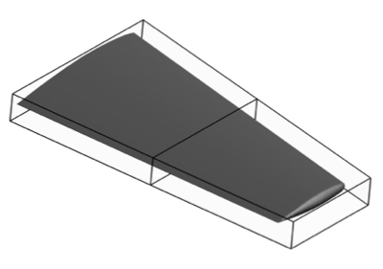
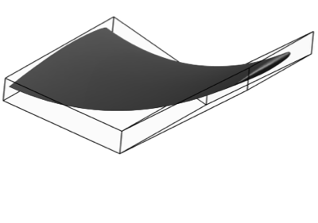
Geometry Parameterization
Parameterize by a Free-Form Deformation (FFD) approach
Technique has origins in the computer graphics industry
Encapsulate geometry in a bounding box and create a mapping between the FFD control points and the mesh surface nodes
FFD control points become the design variables (DVs) with the surface inheriting a smooth deformation
FFD variables are now available in both 2D & 3D with SU² V3.1

Slide 14
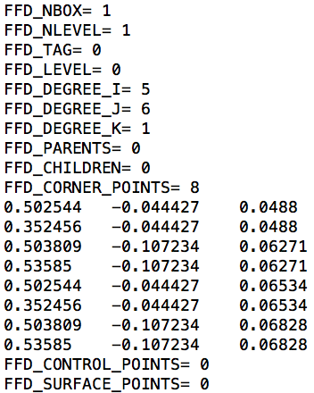
Geometry Parameterization
Set up FFD boxes at bottom of the SU² native mesh file
The new script for Pointwise can generate this information
Initialize the mapping for the FFD box by running SU2_MDC once with option DV_KIND= FFD_SETTING
After completion, a new copy of the mesh with all FFD information is written to disk
Use this new mesh for shape optimization
FFD box specification for our LM 1021 problem

Slide 15
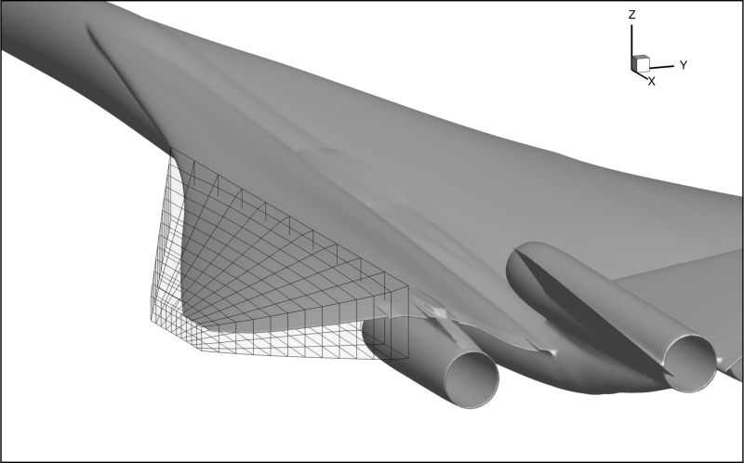
Geometry Parameterization
FFD box for redesigning the Lockheed Martin 1021 configuration
264 FFD Control Point Variables

Slide 16
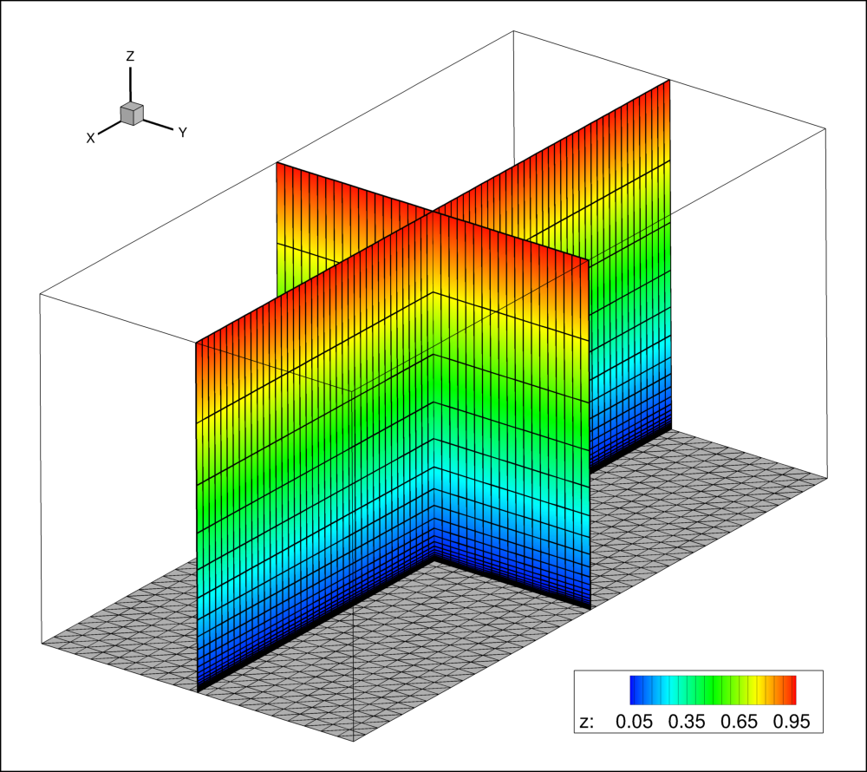
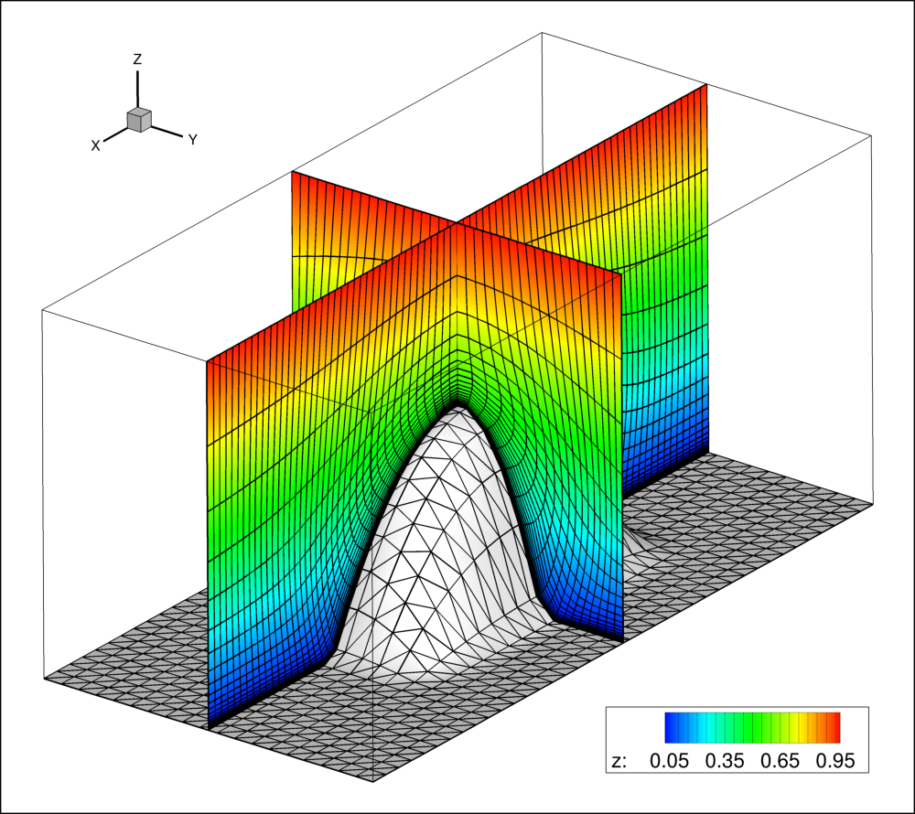
Mesh Deformation
Need robust mesh deformation technique…
Treat the mesh as an elastic solid with non-uniform stiffness
Solve the linear elasticity equations on the mesh for the nodal displacements using the movement of the boundaries as input

Slide 17
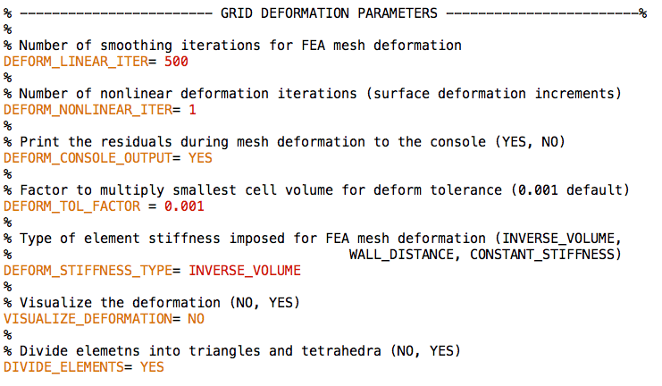
Mesh Deformation
Controls type of cell stiffness. Smaller cells or those near walls will be more rigid under deformation (preserves mesh quality).
Mesh deformation options in SU² V3.1.

Slide 18
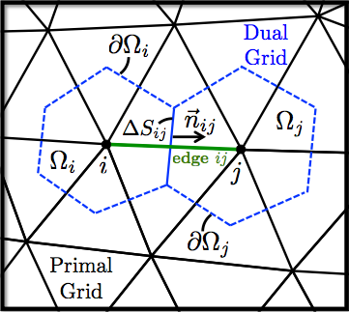
Flow & Adjoint Problem Setup
Unstructured meshes with median-dual control volumes (vertex-based)
Finite Volume Method with second-order schemes
For the supersonic problem, we’ll focus on JST spatial integration (centered) with implicit time integration
Similar schemes for integrating the flow and adjoint equations (adjoint scheme is non-conservative)

Slide 19
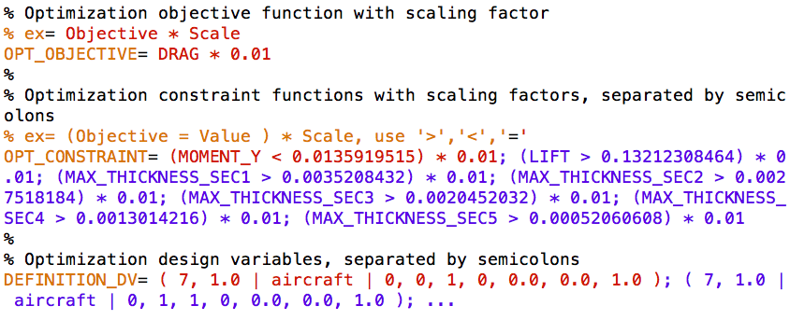
Optimization Problem
Lastly, define your optimization problem in the config file
Choose an objective, constraints (including geometric), and specify your design variables
Full specifications can be found in config_template.cfg
Scaling factor helps optimizer take appropriate first step

Slide 20
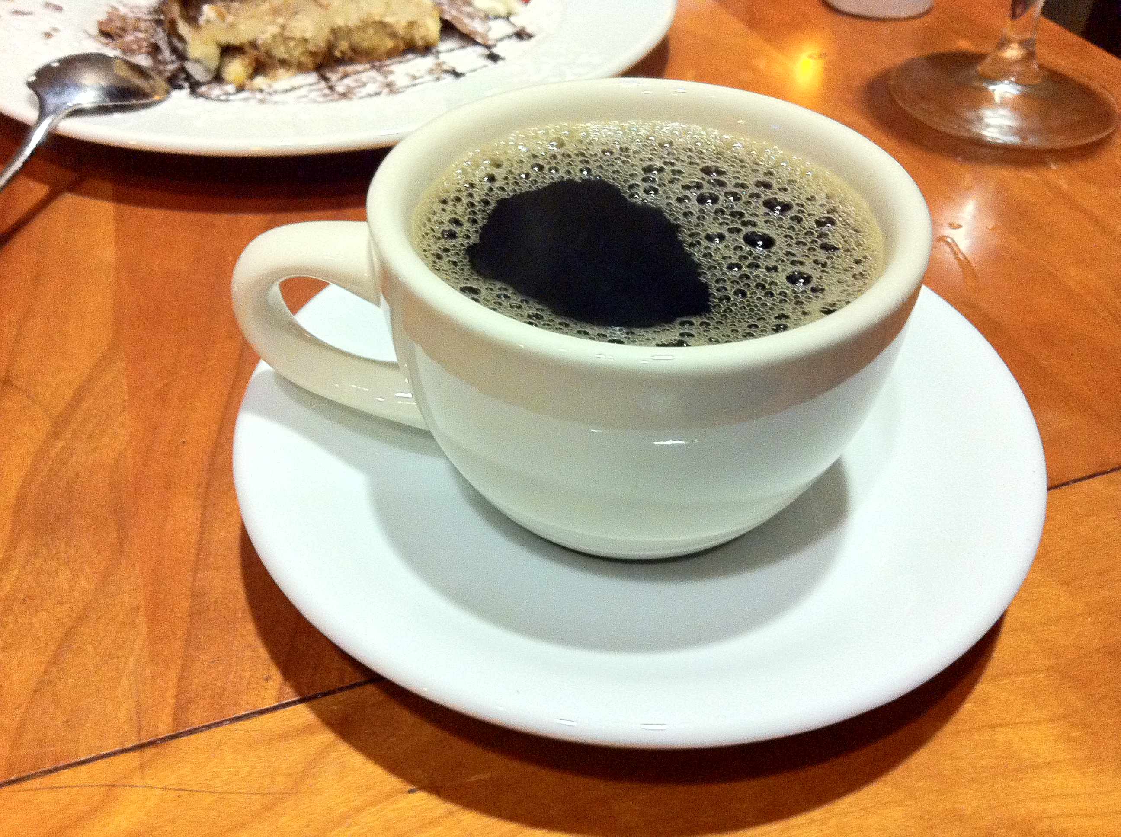
Shape Design in SU²
$ shape_optimization.py –f LM-1021.cfg –p 96

Slide 21
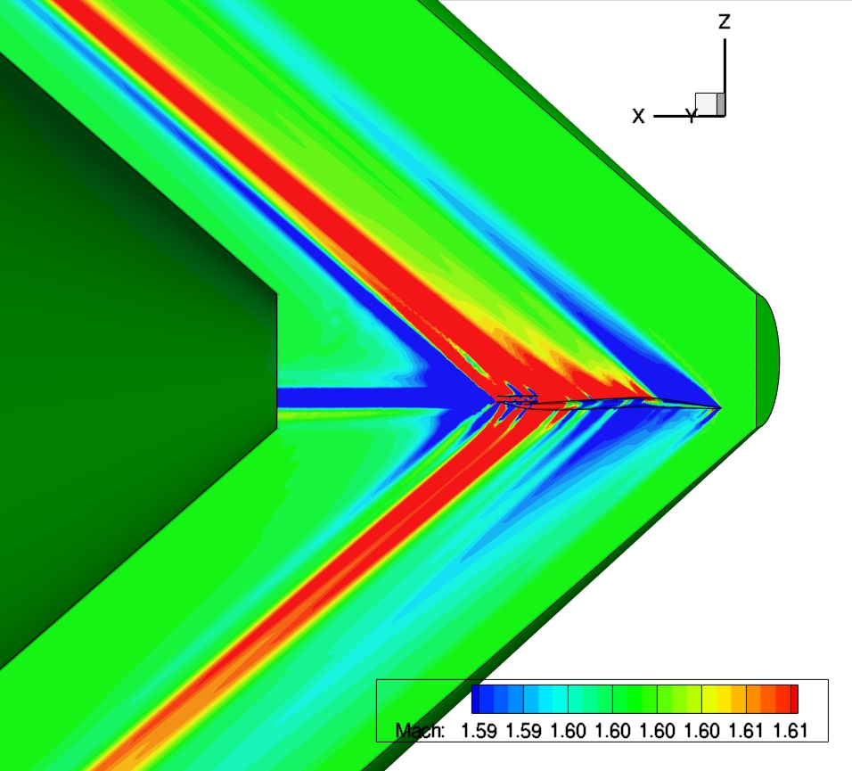
Optimization Results
Shock-aligned hex cells can help maintain accuracy and reduce cost for boom predictions when extracting off-body pressure signatures.

Slide 22
Optimization Results
The Continuous Adjoint in SU² provides surface sensitivities: a measure of the change in the objective function at each node due to small perturbations in the local normal direction.

Slide 23
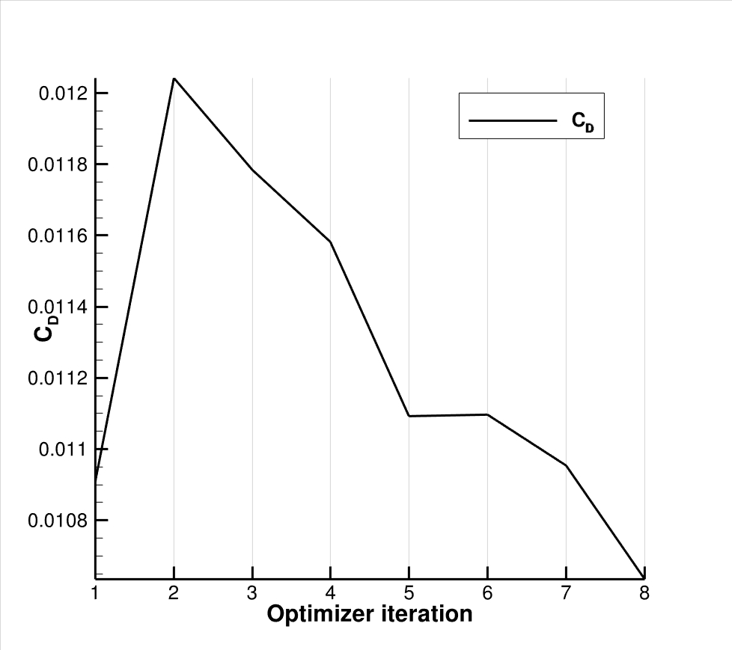
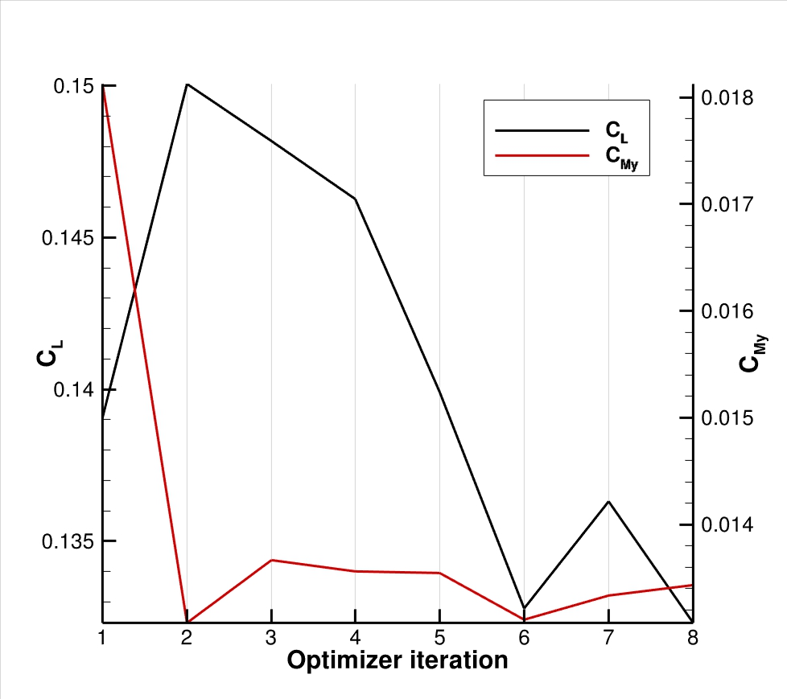
Objective & Flow Constraints
The final design (optimizer iteration 8) satisfies C_{L} and C_{My} constraints with a smaller C_{D} coefficient (3 drag counts less than the baseline value).

Slide 24
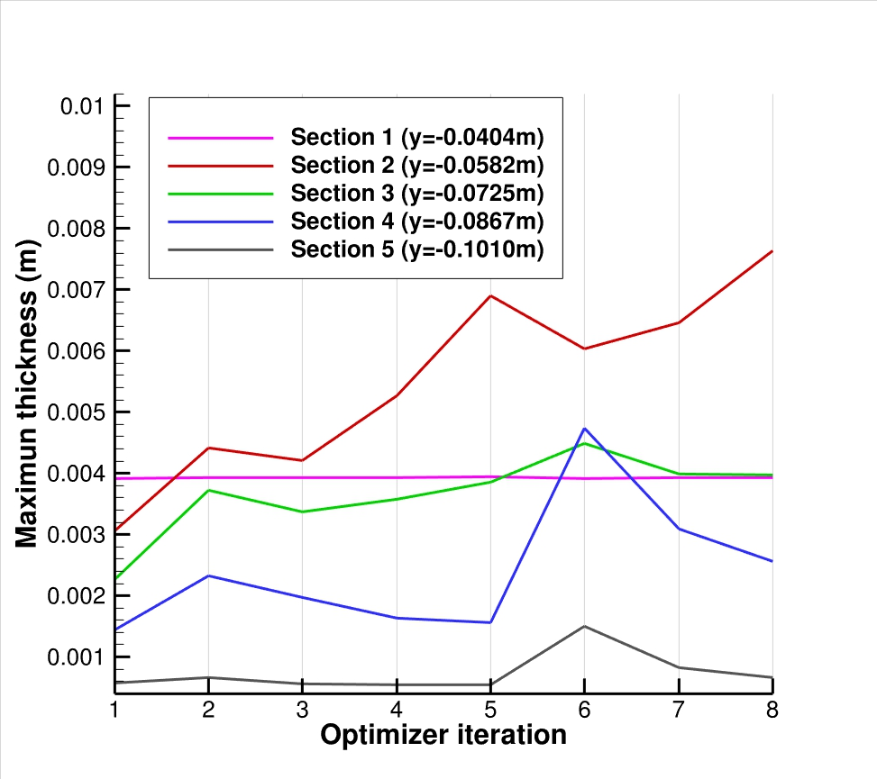
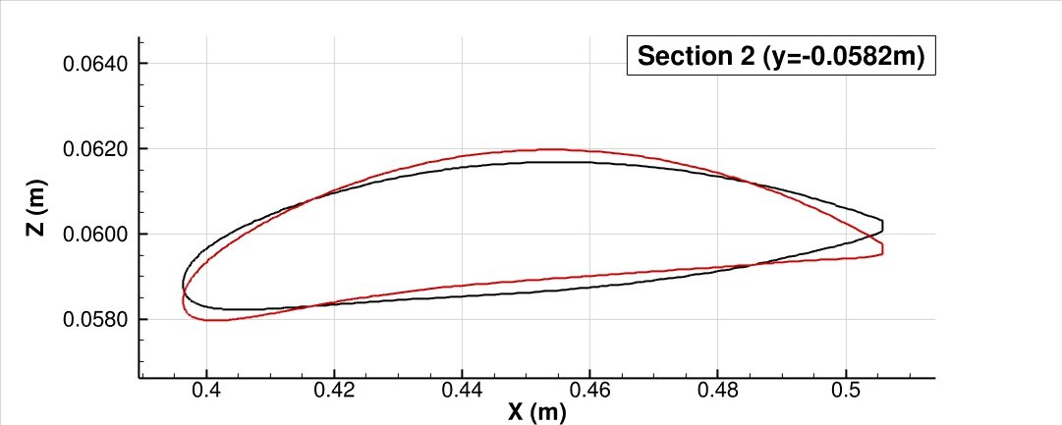
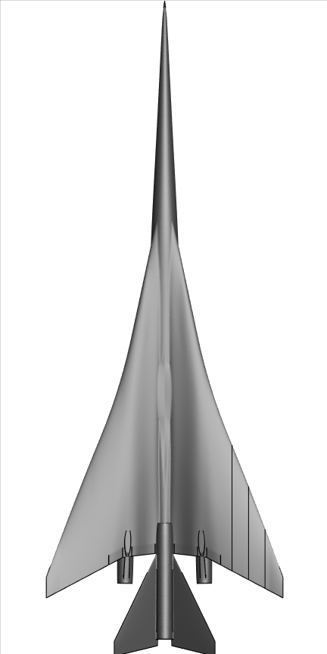
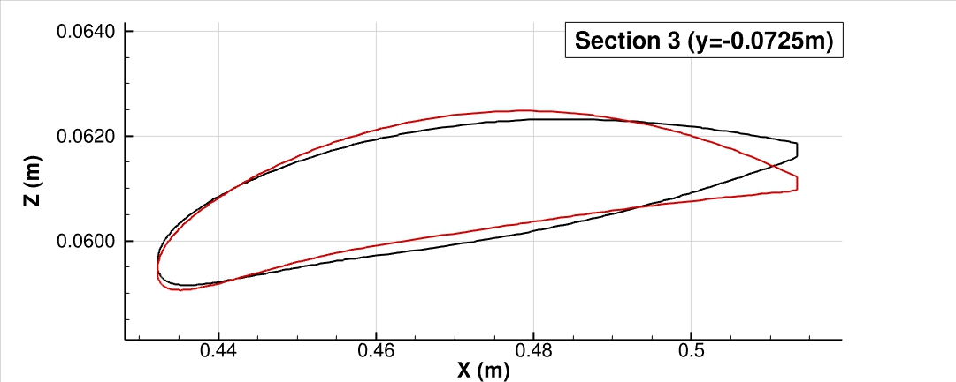
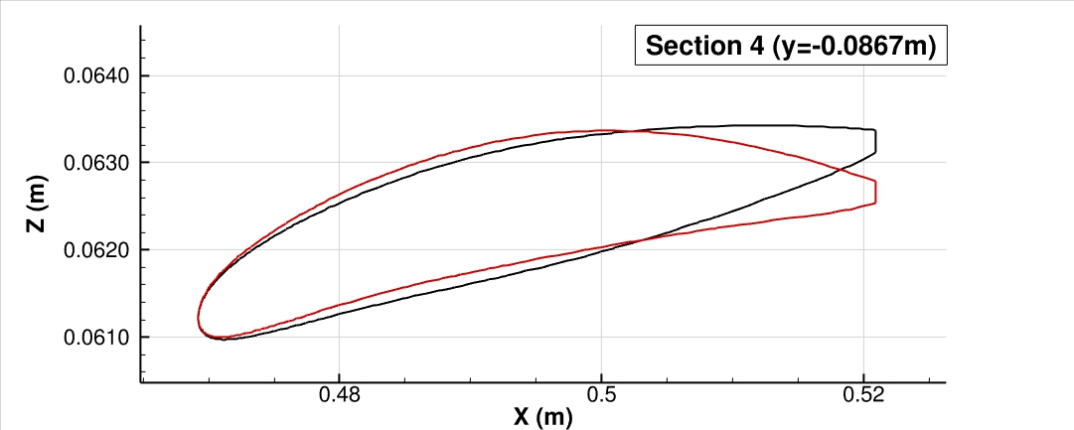
Geometric Constraints
Baseline
Optimizer iteration 3
Baseline
Optimizer iteration 3
However, there is an inadmissible increase in the maximum thickness of section 2 at iteration 4 (a new geometrical constraint is required).
Baseline
Optimizer iteration 3

Slide 25
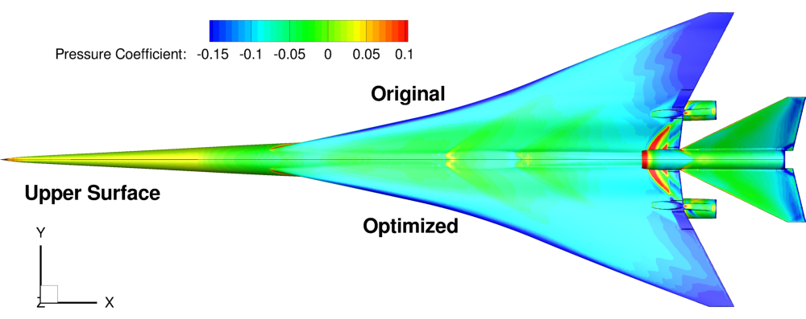
Optimization Results

Slide 26
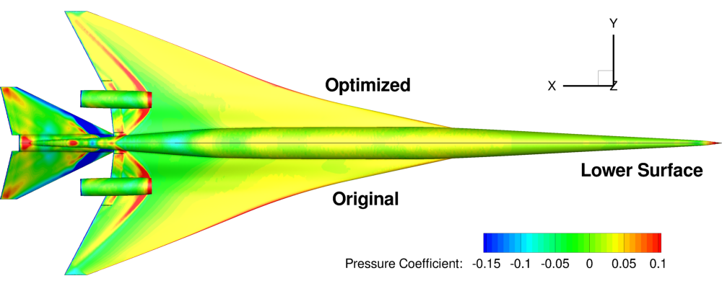
Optimization Results

Slide 27
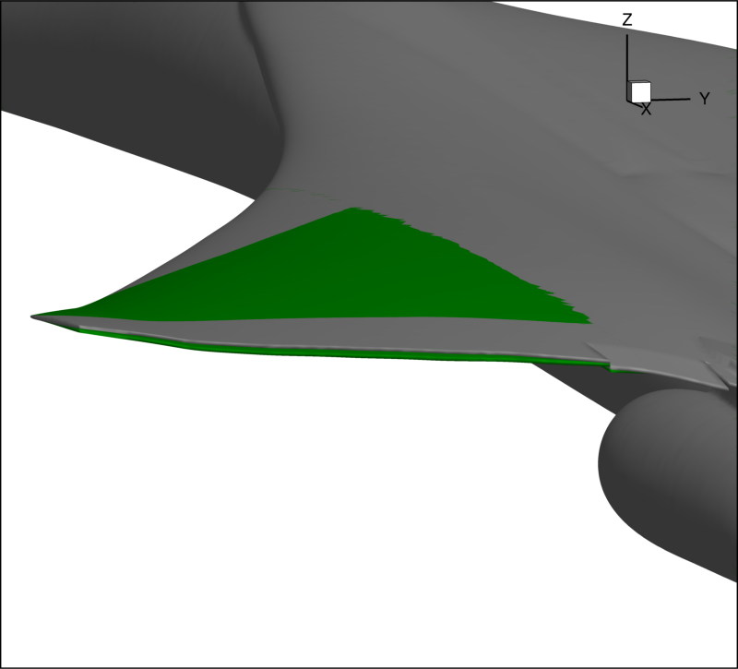
Optimization Results
Original - Grey
Optimized - Green

Slide 28
We’ve Only Scratched the Surface…
Promising results, but this is just the first design iteration
Add more geometric constraints to the wing sections
Consider angle of attack during optimization
Adjust FFD design variables (easy w/ Pointwise script):
Change the shape or move the FFD box around on wing
Add more FFD control points
Hold some FFD control point variables fixed near inboard sections
Try the FFD camber or FFD thickness design variables
Add more FFD boxes to other locations (nacelles?)
Insert nested FFD boxes for finer control (local to leading edge?)
Once a design is finalized, SU2_MDC can export .stl files of the geometry to reintegrate with CAD/manufacturing

Slide 29
Thank-you for attending our webinar
The grid files and scripts used in this webinar as well as the recorded video of the webinar will be available on our web sites tomorrow.
We would like to acknowledge the NASA N+2 Supersonic Program and the Lockheed Martin Corporation.
www.pointwise.com/webinar
http://su2.stanford.edu/training.html
If you have any questions about Pointwise, please email Travis Carrigan at webinar@pointwise.com.
If you have any questions about SU², please email Tom Economon at economon@stanford.edu.

